Slide 1
Grundlagen der Biology IIB
Pflanzenbiologie
Olivier Voinnet
Hormones I + II
1. Overview and biochemical origin
2. GA
3. ABA
4. Auxin
5. Cytokinin
6. Ethylene
7. Brassinosteroids
8. Polyamine
9. Jasmonic Acid
10. Salicylic Acid

Slide 2
OVERVIEW AND BIOCHEMICAL ORIGINS
Definition
• Hormone (from Greek ὁρμή) = « impetus »; « activating/pushing »
• « A chemical released by a cell or a gland in one part of the body that sends out
messages that affect cells in other parts of the organism »
• Only a small amount of hormone is required to alter cell metabolism
• All multicellular organisms produce hormones
• Plant hormones are also called phytohormones
• Cells respond to a hormone when they express a specific receptor for that hormone
• The hormone binds to the receptor protein, resulting in the activation of a signal
transduction mechanism allowing million-fold amplification that ultimately leads
to cell type-specific responses
• Hormones may act differently on different cell types
• Inappropriate hormone doses may trigger opposing effects, making their study
relatively difficult
• A hormone may also regulate the production and release of other hormones..

Slide 3
OVERVIEW AND BIOCHEMICAL ORIGINS
In Animals (I)
Biosynthesis of a particular hormone in a particular tissue
Storage or secretion of the hormone
Transport of the hormone to target cell(s)
Recognition of the hormone by an associated cell membrane or intracellular receptor protein
Relay and amplification of the received hormone via a signal transduction process leading to a cellular response.
6. The reaction of the target cells may then be recognized by the original hormone- producing cells, leading to a down-regulation in hormone production via homeostatic negative-feedback loop
7. Degradation of the hormone.
>60 known hormones in humans, and there may be more (sexual arousal):
▪ stimulation or inhibition of growth
▪ mood swings
▪ induction or suppression of apoptosis (programmed cell death)
▪ activation or inhibition of the immune system
▪ regulation of metabolism
▪ preparation of the body for mating, fighting, fleeing, and other activity
▪ preparation of the body for a new phase of life, such as puberty, parenting, menopause
▪ control of the reproductive cycle
▪ hunger cravings

Slide 4
OVERVIEW AND BIOCHEMICAL ORIGINS
In Animals (II)
• Some hormones function over long-distances in the blood stream
- from endocrine glands (thyroid, ovaries, testes)
- from neuro-secretory cells
• Others function at close ranges
- signal transduction via synapses (neuro-secretory cells)
- paracrine signal transduction (diffusion from one cell to another)
• Various types of hormones
- steroid hormones, mostly derived from cholesterol (e.g. testosterone)
- peptide hormones are chains of amino acids devided into:
- short peptide (THR, vasopressin);
- protein hormones (insulin, growth hormone);
- Monoamine hormones are derived from single aromatic amino acids like phenylalanine, tyrosine, tryptophan (adrenaline);
- Gazeous hormones include Nitrogen monoxyde (vasodilatation, increased blood flow)
• Modes of action
- receptor binding
- signal transduction
• Regulation
- enzyme activity
- gene expression

Slide 5
OVERVIEW AND BIOCHEMICAL ORIGINS
In Plants (I)
• Similar in their principle to animal hormones, but not so well understood
• Not secreted in specialized organs (no ‘glands’)…
• …but sometimes more specific biosyntetic zones
• Drastically different effects depending on concentration:
- low auxin levels -> main root elongation
- higher levels -> elongation stopped, lateral root formation enhanced
• Rarely act in isolation, and often in coordination with other hormones
- Auxin + Cytokinin -> cell division
• Most phytohormones are transported by the phloem and then:
- are actively transported from cell to cell
- or diffuse passively through the cell wall
• Possible gazeous emissions in the atmosphere (ethylene) or in the rizosphere (strigolactone)
• 13 distinct plant hormones are known, but, as in animals, there may be many more!

Slide 6

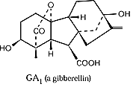
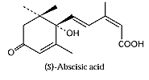


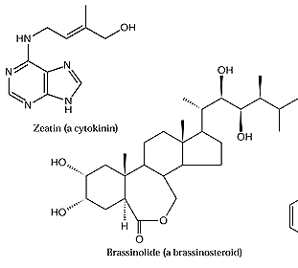

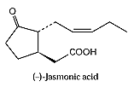
monoamine- hormones
• Phytohormones divided into 3 main classes
Isoprenoid-derived hormones
tryptophane
phenylalanin
methionin
arginin
Lipid-derived hormones
Linoleate

Slide 7
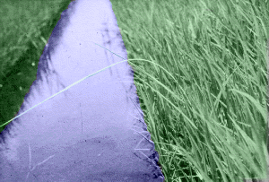
GIBERELLIC ACID (GA)
« Bakanae » disease in rice
1898 : Hori shows that symptoms are caused by infection with a fungus in the genus fusarium;
1912: Sawada suggests elongation in rice seedlings infected with bakanae fungus might be due to a « stimulus » derived from fungal hyphae;
1930s: perfect stage of the fungus is named Gibberella fujikuroi and can be cultured in the lab;
1934: Yabuta isolate a crystalline compound from the fungal culture filtrate that induces growth of rice seedlings at all concentrations tested. Named « fusaric acid » and later « giberillic acid » or GA;
1950s: Optimal fermentation procedures for the fungus allow large-scale production of GA
In parallel, researchers realize that a compound with similar properties is naturally produced by plants! It is isolated through the same procedures and found to:
• Stimulate stem elongation by promoting cell division and elongation
• Stimulates bolting/flowering in response to long days
• Breaks seed dormancy in some plants which require stratification or light to induce germination
• Stimulates enzyme production (α-amylase) in germinating cereal grains for mobilization of seed reserves
• Induces maleness in dioecious flowers (sex expression)
• Can delay senescence in leaves and citrus fruit
✓
✓

Slide 8
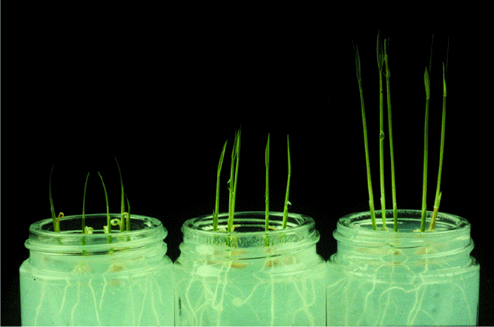
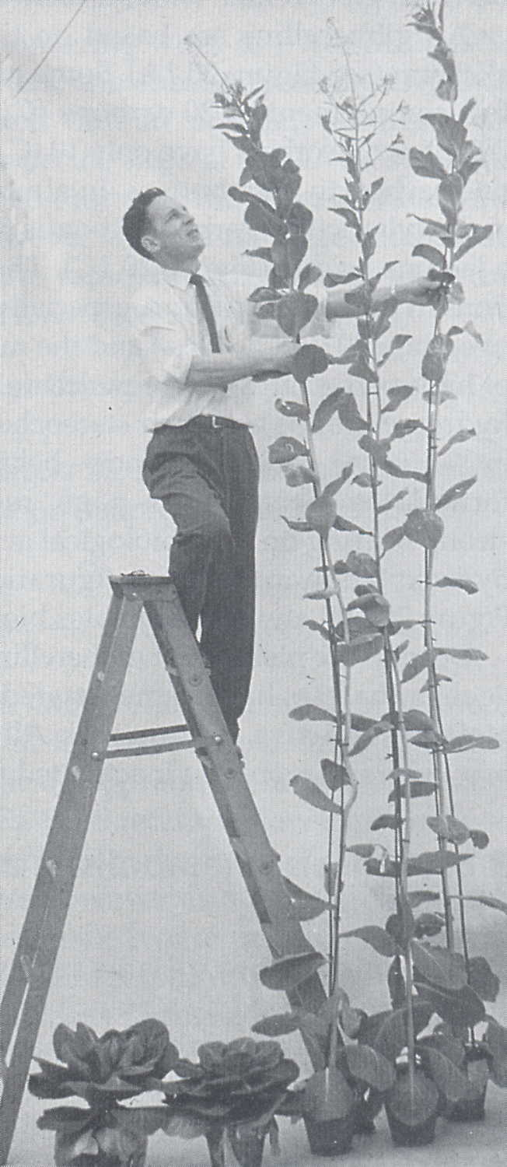
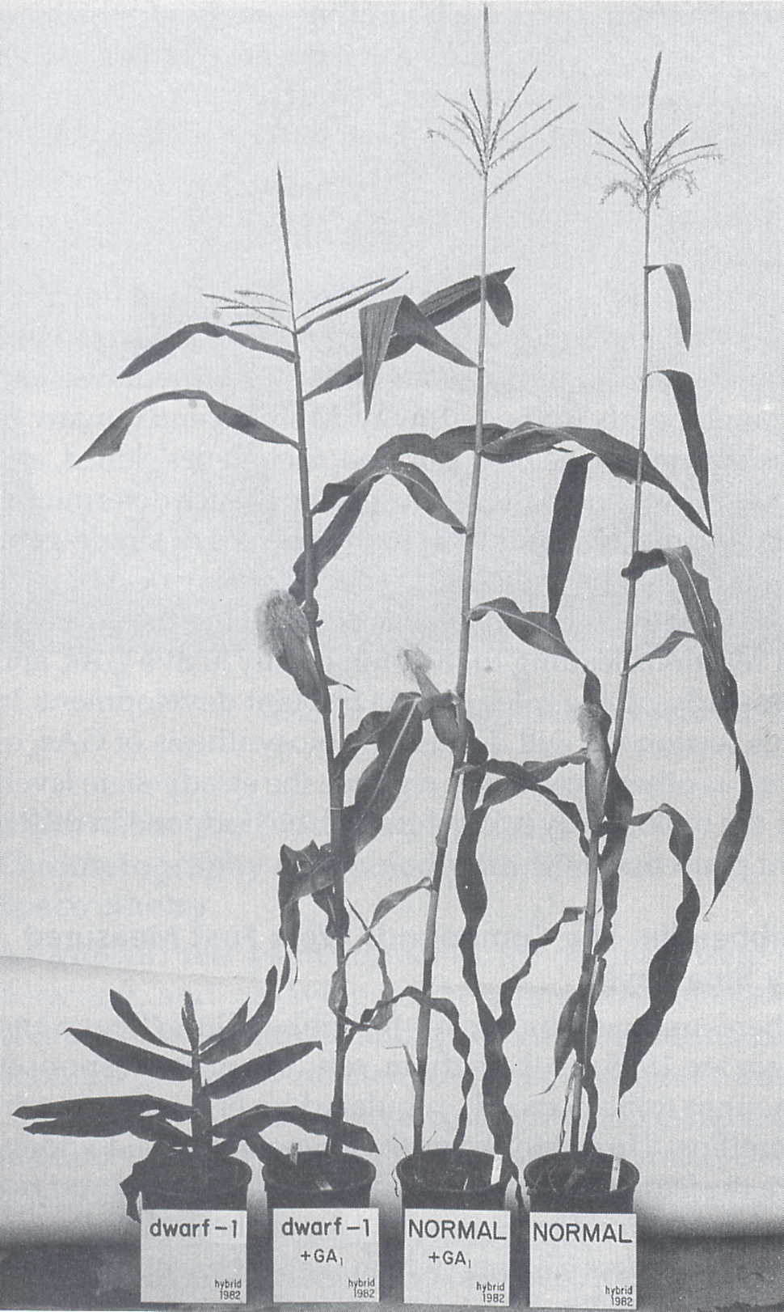
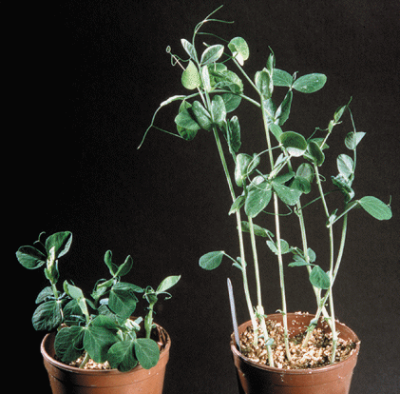
Gibberellins promote
cell elongation
Tanginbozu Dwarf Rice
+GA
Cabbage (long day plant)
Dwarf maize
Dwarf pea

Slide 9
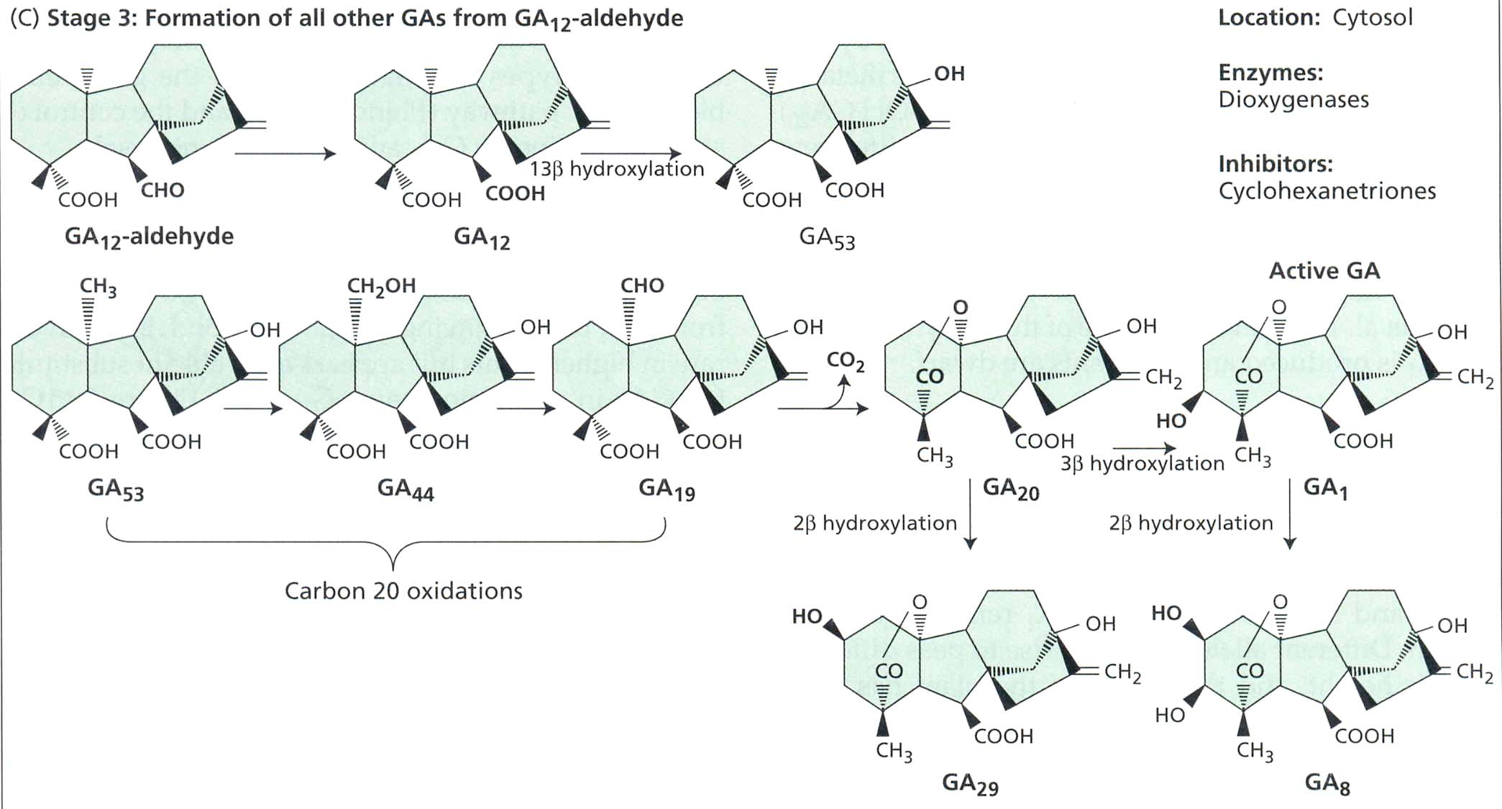
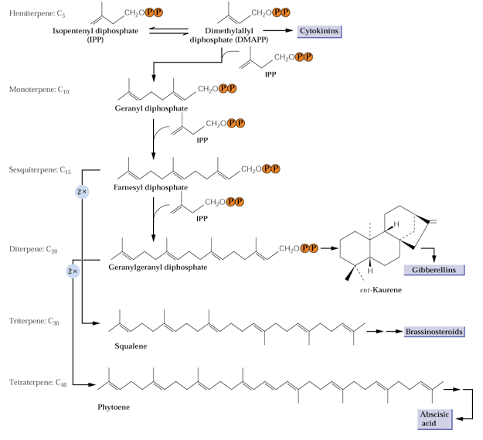
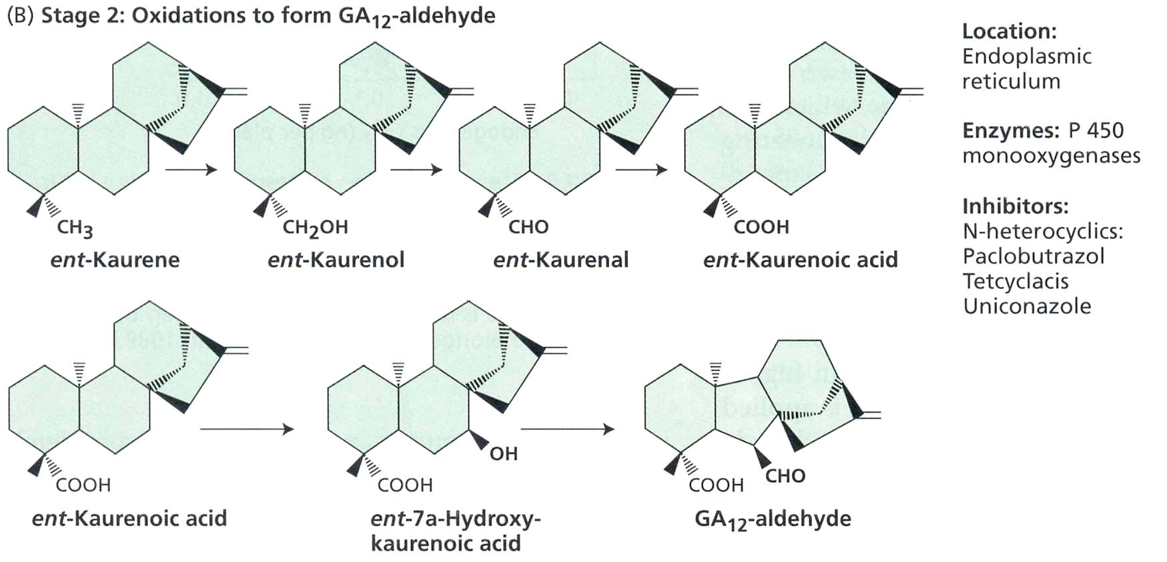
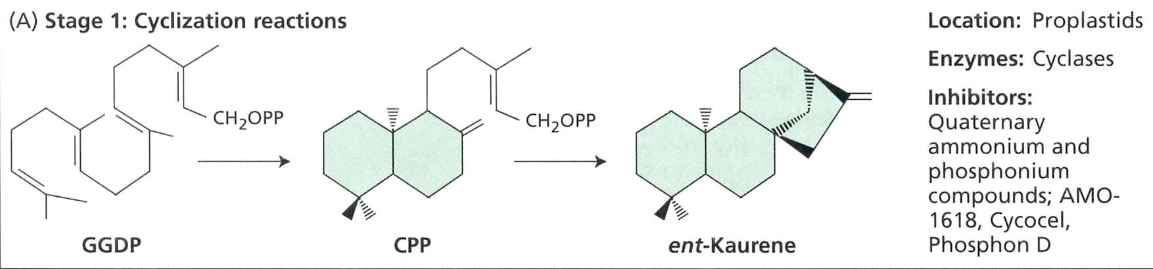
Cytoplasm: dioxygenases
GA biosynthesis takes place in 3 different sub-cellular compartments
Strictly regulated by:
• Light
• Temperature
• Feedback
IP-PP
ER: P450 monooxygenases
ent-Keuren
GG-PP
Proplastisds: Cyclases
Notes:
ispentenyl diphosphate -> geranylgeranyl diphosphate -> ent keuren -> GA12-ALDEHYDE -> GA
P450 monooxygenases mediate hydroxylation

Slide 10
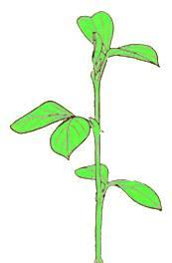


Unlike auxin, GA is not transported in a polar way
The same amount of GA moves from the upper donor block to the lower block no matter the polarity of the stem segment. By contrast, auxin moves much more efficiently from stem apex to base.
Normal orientation
Inverted orientation
Adapted from Kato, J. (1958) Non polar transport of gibberllin through pea stem and a method for its determination. Science 128: 1008-1009.
Notes:
See “Teaching Tools in Plant Biology 7 – The Story of Auxin” for more on polar auxin transport.

Slide 11
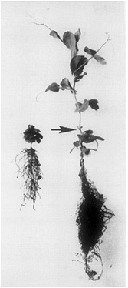
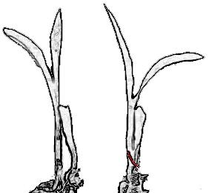
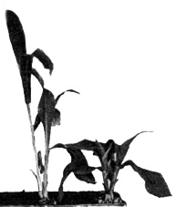
GAs are graft-transmissible; they can move long distances
WT - d1
In pea, a mutant na shoot is rescued by grafting onto a
Na root.
Maize seedlings are grafted side-by-side
d1- d1
na
Na
In maize, GA or a GA-precursor moves from the wild-type plant to d1 and promotes growth.
na
na
Proebsting, W.M., et al. (1992). Gibberellin concentration and transport in genetic lines of pea : Effects of grafting. Plant Physiol. 100: 1354-1360; Katsumi, M., et al. (1983). Evidence for the translocation of gibberellin A3 and gibberellin-like substances in grafts between normal, dwarf1 and dwarf5 seedlings of Zea mays L. Plant Cell Physiol. 24: 379-388 Copyright 1983 Japanese Society of Plant Physiologists, with permission.
Notes:
The na mutant pea shoot does not produce GA, but when grafted onto Na roots it elongates, indicating that GA has been translocated from root to shoot. Similarly, the maize d1 mutant is dwarfed when grafted to another d1 mutant, but elongates when grafted to a wild-type plant, showing translocation of GA from the WT graft partner to the d1 mutant.

Slide 12
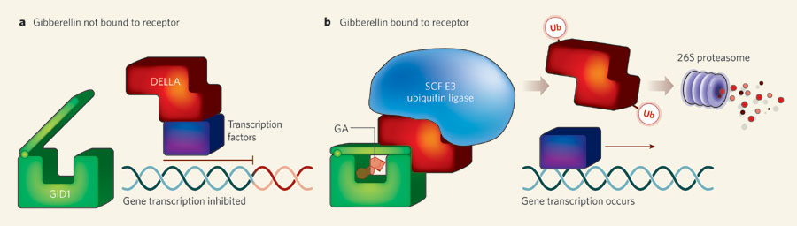
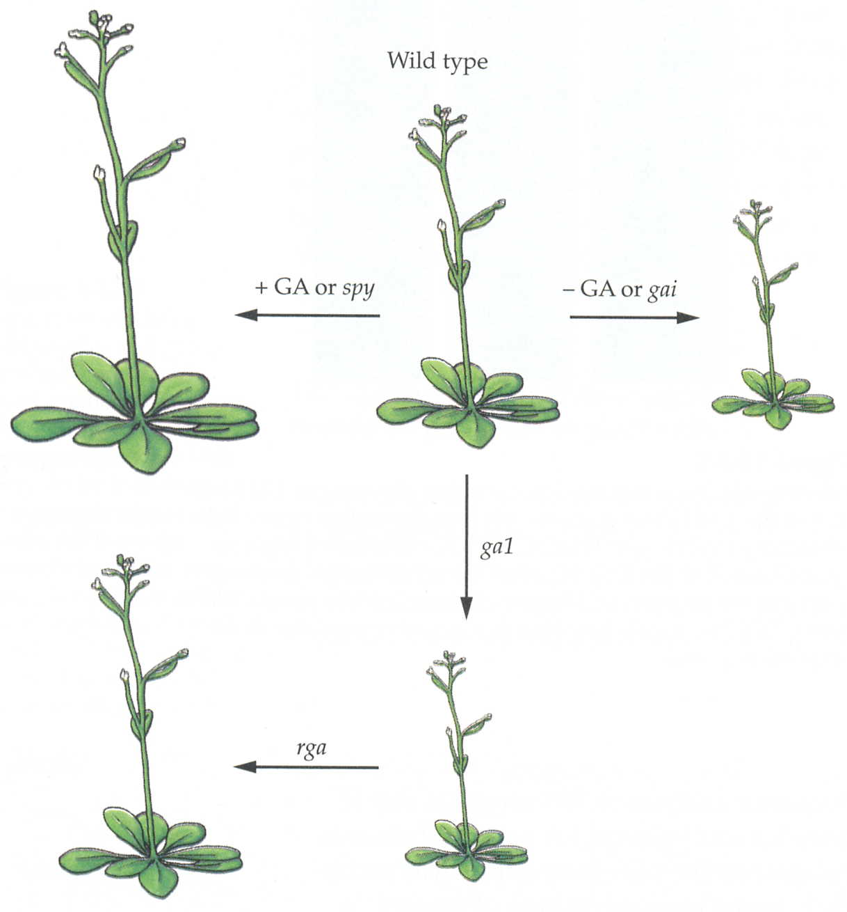
Analysis of Arabidopsis ga mutants reveals a potential signal transduction pathway, which controls GA-dependent elongation growth
X
*
*
*
X
*spy: recessive mutation,
GA receptor is constitutively active
*spy
*gai
*gai: dominant mutation,
GA receptor not functional
*ga1: dominant mutation, DELLA protein
Repressor constitutive
*ga1
*rga: revertant of ga1: repressor is altered
*rga

Slide 13
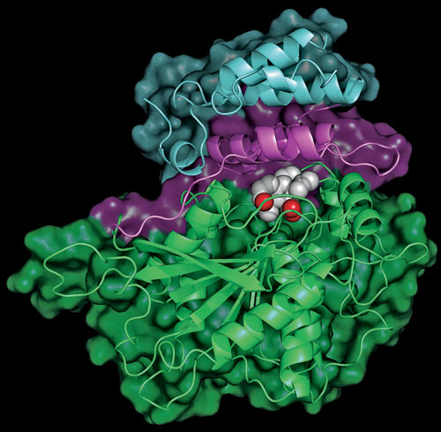
Crystal structure of GID1, a nuclear GA receptor
DELLA
repressor
GA
Receptor
N terminus
GID1
Nuclear
receptor
• Binding of gibberellin within its receptor…
• causes the receptor's N-terminus to close over the hormone like a lid…
• closing the lid provides a platform for binding gene transcription blockers or DELLA…
• thereby making them available for destruction

Slide 14
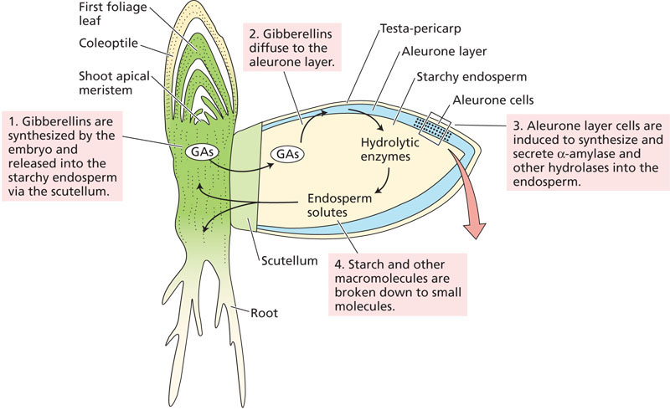
During seed germination, starch degrading enzymes are mobilized through a GA dependent signal transduction pathway

Slide 15
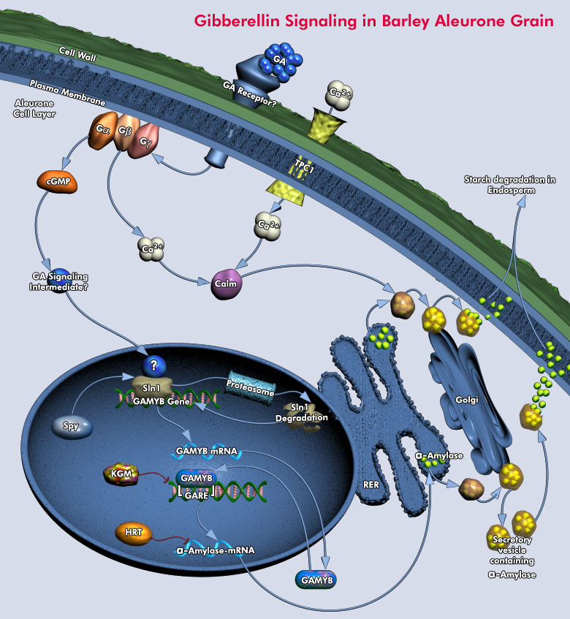
GA binds extracellular receptor
G proteins activated : transient elevation of cyclic-GMP
Calcium signalling activated to induce golgi-vesicle secretion
An unknown signal transduction cascade is activated
And reach the DELLA factor Sln1 to induce Sln1 degradation
GAMYB is activated
Alpha-amylase is activated and loaded into vesicles
But membranous GA receptor remains unknow!!
Notes:
----- Notes de la réunion (02/05/11 22:42) -----
GA is perceived on the surface of Barley Aleurone cells by an unidentified outward-facing Plasmamembrane–associated GA Receptor. Binding activates, directly or indirectly, Second messengers and G-proteins. This interaction stimulates a Signal Transduction Cascade that involves the phosphorylation or dephosphorylation of proteins on Serine, Threonine, or Tyrosine. Eventually, the Signal reaches the nuclear DELLA Protein, Sln1. The DELLA proteins are highly conserved negative regulators of GA signaling in Barley. These DELLA proteins are named after a conserved Amino Acid motif near their N-termini. The DELLA proteins form a subfamily within a family of putative transcriptional regulators known as GRAS. Sln1 acts as a repressor of GA responses, inhibiting the transcription of the gene encoding the GAMyb activator of the Alpha-Amylase response. The GA signal alters Sln1, resulting in Proteasome-dependent Sln1 destabilization. The inactivation of Sln1 repressor allows the expression of GAMyb genes, as well as other genes, to proceed through transcription, processing and translation. The lag time between Sln1 disappearance and the expression of GAMyb remains poorly understood. The newly synthesized GAMyb proteins then enter the nucleus and binds to the promotor genes for Alpha-Amylase and other hydrolyting enzymes. Spy (Spindly) protein negatively regulates GA responses in Aleurone. Two of the HSI (Hordeum Spy-Interacting) Proteins, HSImyb and HSINac inhibited the GA up-regulation of Alpha-Amylase expression in Aleurone. Recent evidence suggests that the GA regulation of GAMyb involves both transcriptional and post-transcriptional control. A GAMyb binding protein, Kgm, has been identified as a repressor of transcriptional activation of an Alpha-Amylase promoter by GAMyb. Kgm, a Mitogen-Activated Protein–like Kinase, is expressed in Aleurone cells in the absence of GA. HRT is a repressor of Alpha-Amylase gene expression. This nucleus-localized Zinc-finger protein binds to a 21-bp sequence containing the TAACAAA element, but at present there is no evidence for GA control of its repressor function (Ref.3 & 4)

Slide 16
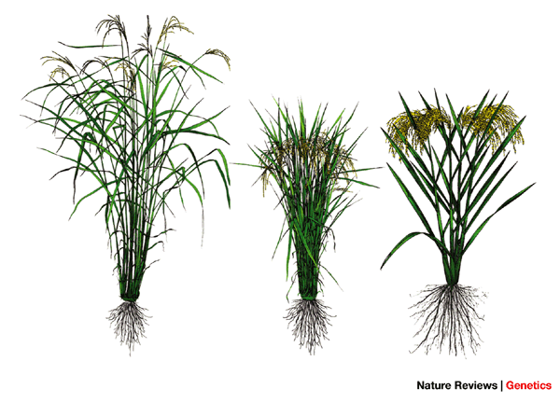
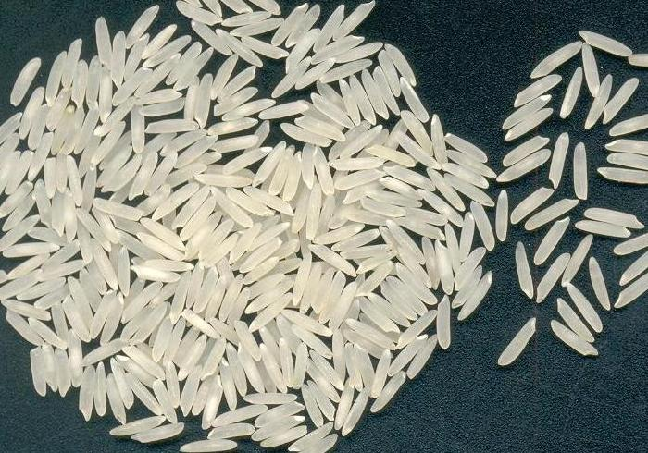
GA are extremely important food sustainability worldwide e.g. « Green revolution » rice
• Development of high yielding varieties of cereal grains between the 60s and 70s
• High yielding varieties have higher nitrogen absorbing potential
• But cereals absorbing extra nitrogen typically fall over before harvest
• so dwarf cultivars were created by breeding dwarfism genes including ga genes
• reduced stem growth allows photosynthetic investment in the stem to be realocated to grain production and filling, increasing yield dramatically

Slide 17
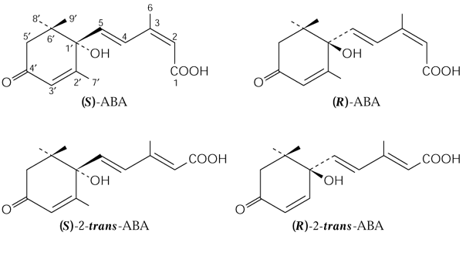
ABSCISIC ACID (ABA)
• 1960s: a factor inducing bud dormancy in woody plants is identified (dormin)
• 1960s: a factor inducing abscission of fruits and flowers is identified (abscissin)
• it is the same factor !
• ABA was later found to have no effect on organ abscission, but the name stayed…
• Only in 1992 did plant physiologists agreed on the term “abscisic acid” !
• Abscisic acid (ABA) has an asymmetric C in the 1’ position acting as a chiral center
• possible S or R enantiomers
• only S enantiomer exists in plants
• Light converts Cis into Trans ABA

Slide 18
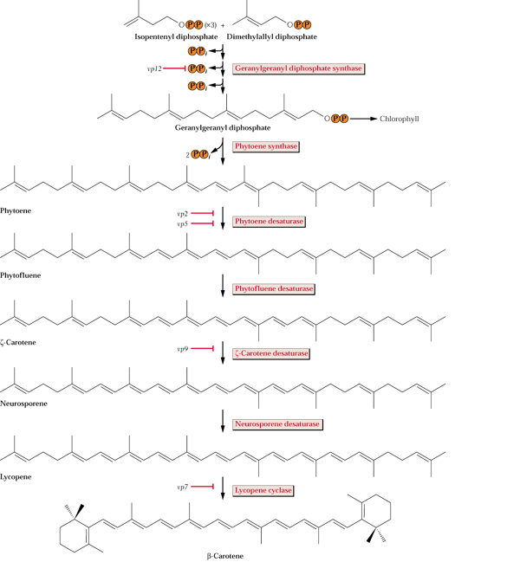
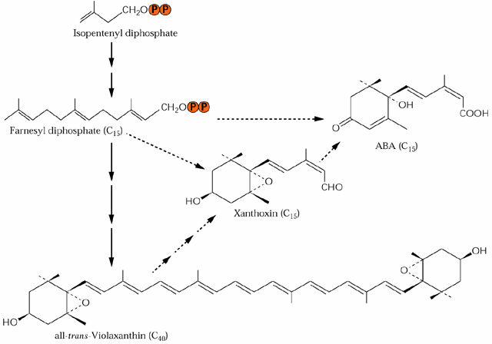
ABA can be synthesized via a direct (FPP) or indirect (Xanthophyll) biochemical pathway
chloroplast
• starts from beta carotene produced in chloroplasts
• hence, biosynthesis mostly in leaves, but may occur in all organs
• ABA is a breakdown product of violaxanthin (C40)
• leading, among other products, to xanthonin (C15), which is unstable
• Direct synthesis also occurs from FPP (C15)
Farnesyl
diphosphate
ABA
xanthonin
Beta-Carotene
vp = “vivipary” mutants in maize
violaxanthin

Slide 19
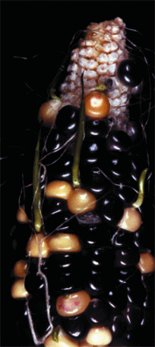
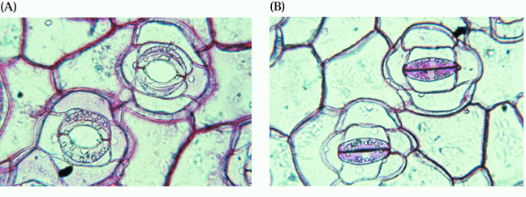
• Inhibits shoot growth but will not have as much effect on roots or may even promote growth of roots
• Inhibits the affect of gibberellins on stimulating de novo synthesis of alpha-amylase
• Induces gene transcription especially for proteinase inhibitors in response to wounding
But ABA has two major roles
• Stimulates the closure of stomata (water stress promotes an increase in ABA synthesis).
• Induces seeds to synthesize storage proteins and to avoid early germination (dormancy), which is broken by endogenous or exogenous GA). The ABA/GA ratio controls germination naturally
Vivipary maize mutant
ABA-induced stomatal closure

Slide 20
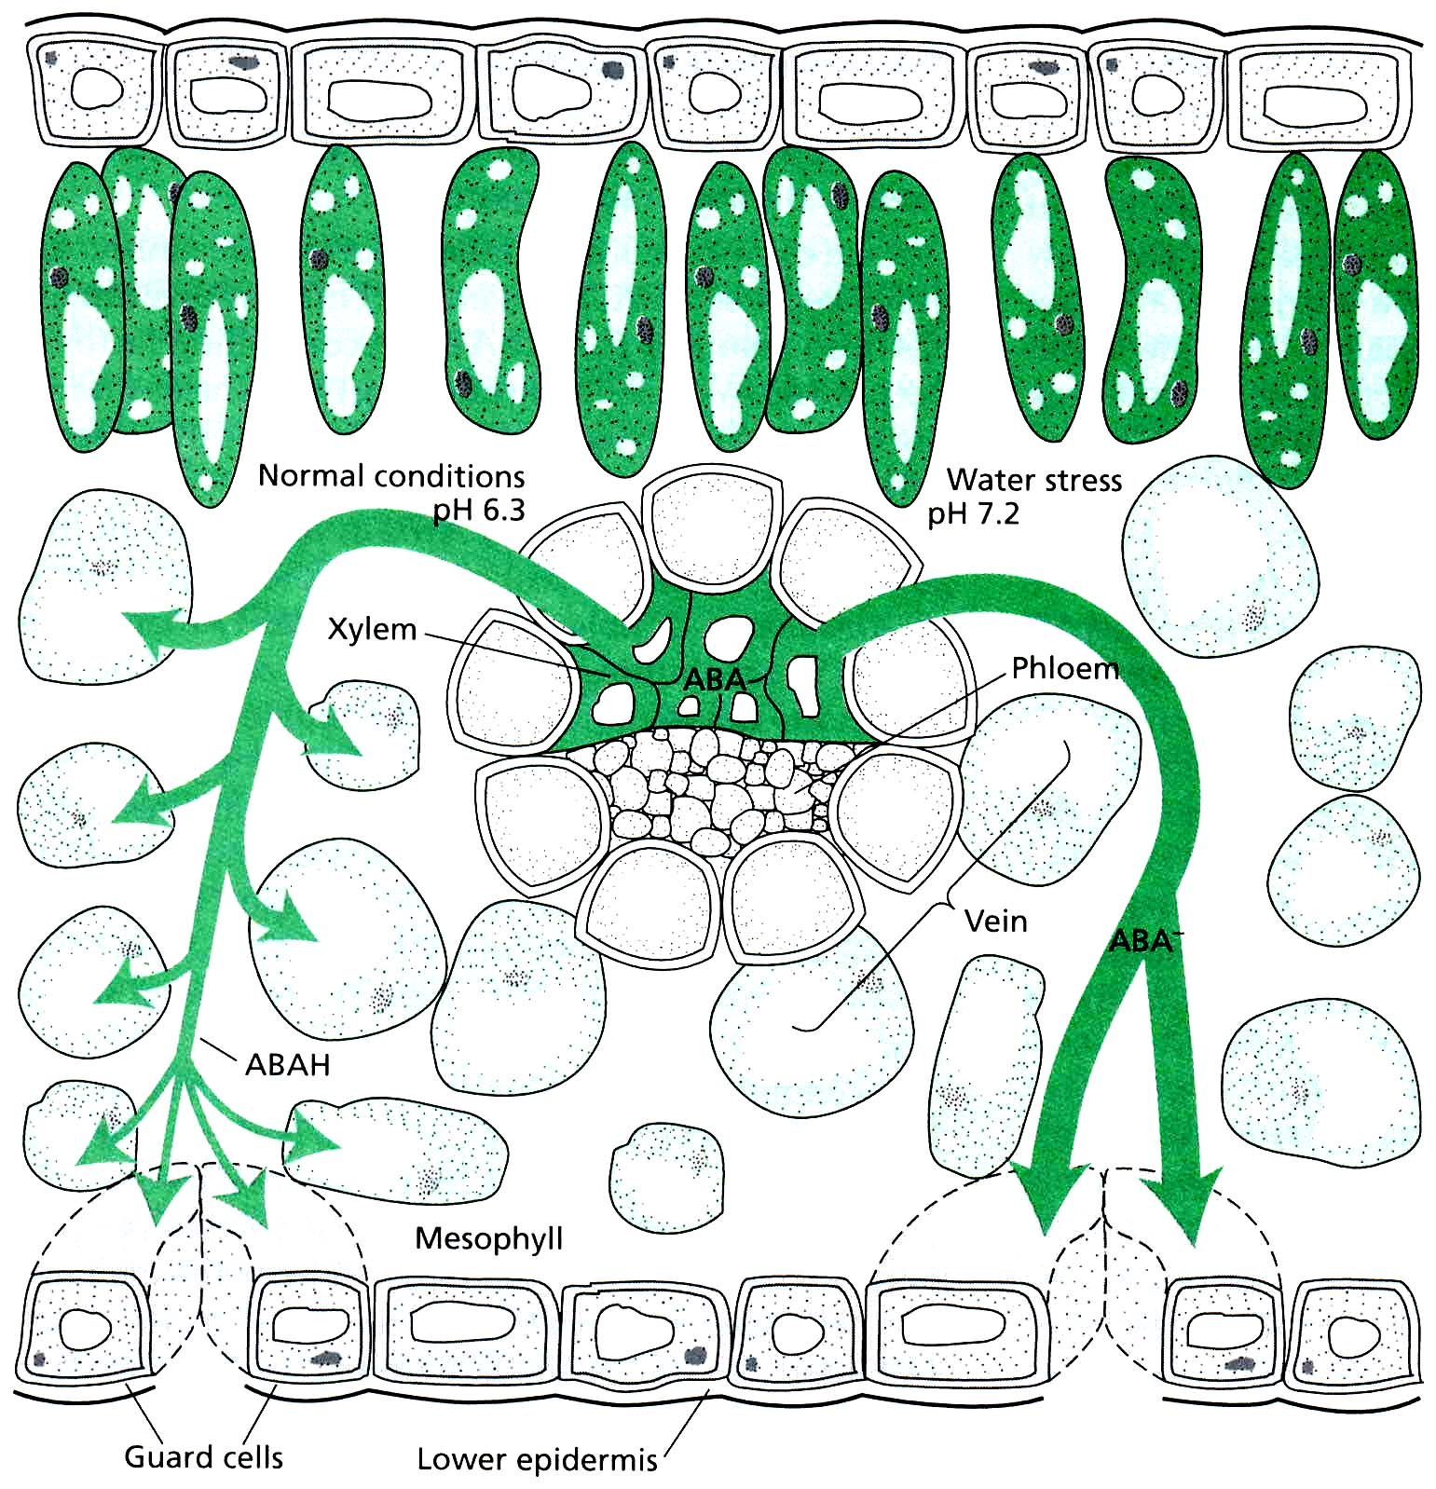

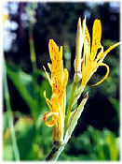
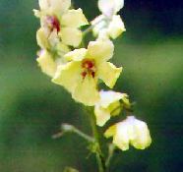
H₂O-stress, Tutankhamen, Canna compacta and Verbascum blattaria
• During water stress, ABA moves from root to shoot in the Xylem
• In normal conditions (acidic pH) ABA is degraded and distributed to parenchyma cells
• In water stress, neutral pH stabilizes ABA and distributes it to guard cells (shrinking)
3000 years old rye seeds!
600 years old
King Tutankhamen
Canna compacta
(Blumenrohr)
germinates after burial in bottles
Verbascum blattaria
(Königskerze)

Slide 21
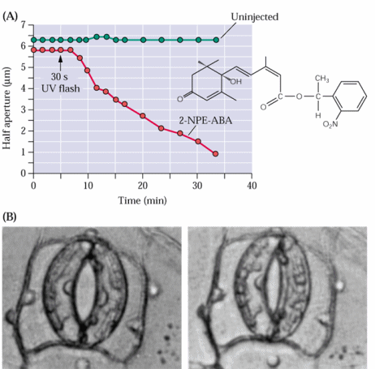
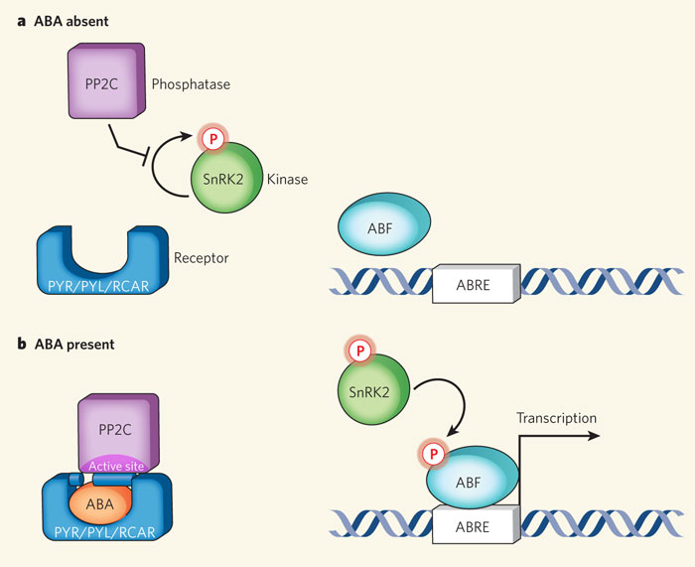
The contribution of ABA to stomatal closure can be shown directly, but the signal transduction pathway is not fully known yet
In the absence of ABA, the phosphatase PP2C is free to inhibit autophosphorylation of SnRk kinases
• Closure of guard cells within minutes
ABA enables PYR/RCAR proteins to bind and sequester PP2C
ABA receptor (PYR/RCAR) only cloned in 2010!
This relieves inhibition of SnRk, which becomes autoactivated and phosphorylates ABF transcription factors
Other ABA receptors likely exist.
Notes:
1-(2-nitro)phenylethyl ester (2-NPE-ABA)

Slide 22
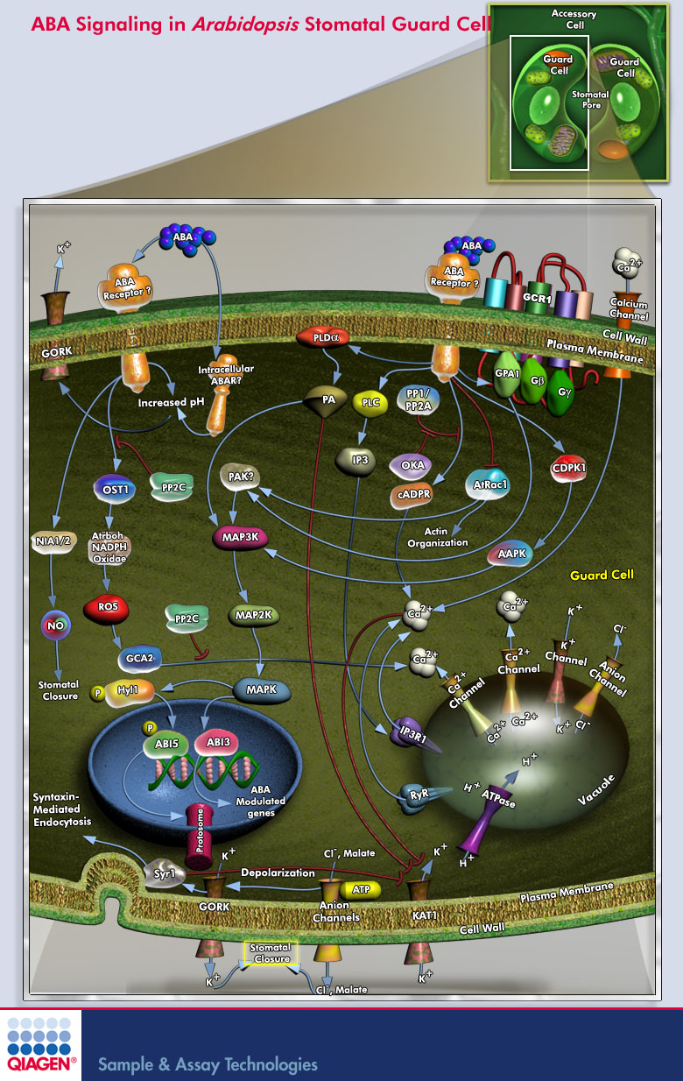
Stomata closure is positively correlated to an increase in cytosolic Ca²⁺ within the guard cells, released from their vacuole

